Slide 1
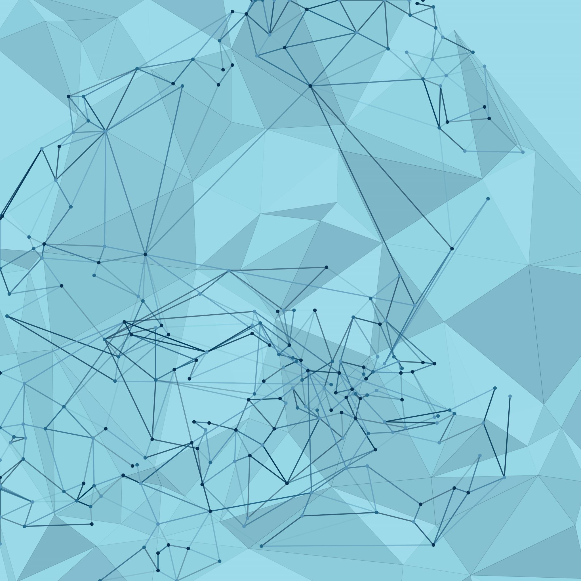
Using Generative AI to generate images

Slide 2
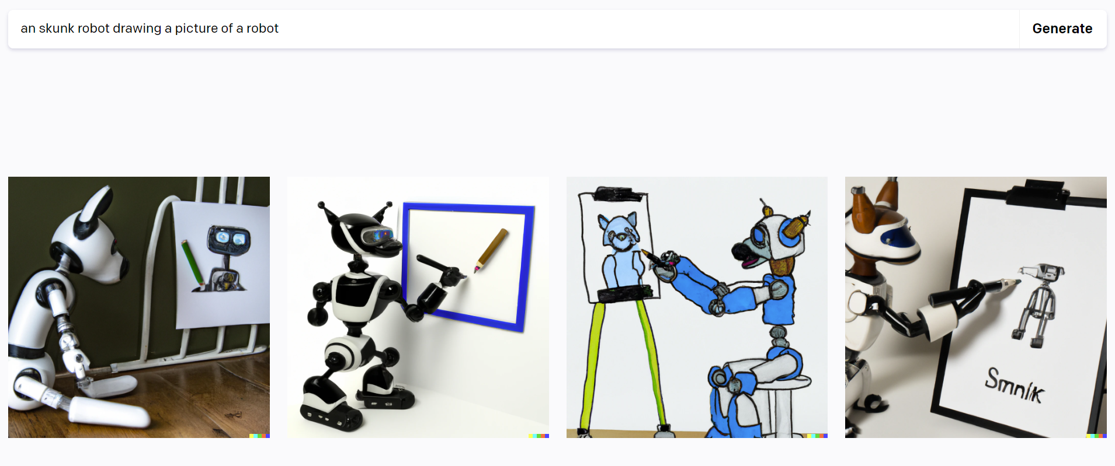
Introduction
Artificial intelligence has made significant progress in content generation, spanning from translating text into visuals to crafting intricate artworks and animations. This is particularly evident in image synthesis, where tools like Midjourney, Stable Diffusion and DALL-E have streamlined the process. Generative AI models underpin these capabilities, proving vital for individual creators and businesses.

Slide 3
Table of contents:
What are generative AI models?
Understanding image synthesis and its importance
Midjourney AI- How does it work?
DALL·E 2- How does it work?
Generating creative prompts automatically through code
Superpowers of generative AI models
Use Generative AI models effectively
Applications of generative AI models for image synthesis

Slide 4
What are generative AI models?
Creating Realistic Images: Generative AI models generate lifelike images by learning patterns from large datasets of existing images.
Complex Algorithms: These models use intricate algorithms, like Generative Adversarial Networks (GANs), transformers, diffusion models, to craft new images that resemble the training data.
Diverse Applications: Generative AI enhances art, entertainment, and medicine, producing innovative visuals, aiding training, and generating realistic virtual environments.

Slide 5
Understanding image synthesis & its importance
Image synthesis involves generating new visuals using AI algorithms, shaping diverse content from existing data.
Enhancing Creativity: Image synthesis fuels creativity, enabling artists and designers to explore novel concepts and push creative boundaries.
Data Augmentation: In fields like machine learning, image synthesis augments datasets, improving model performance and generalization.
Virtual Worlds: Synthesized images enhance virtual environments, making video games, simulations, and virtual reality more immersive.
Medical Applications: Image synthesis aids medical training, generating synthetic medical images to advance diagnostics and research.

Slide 6
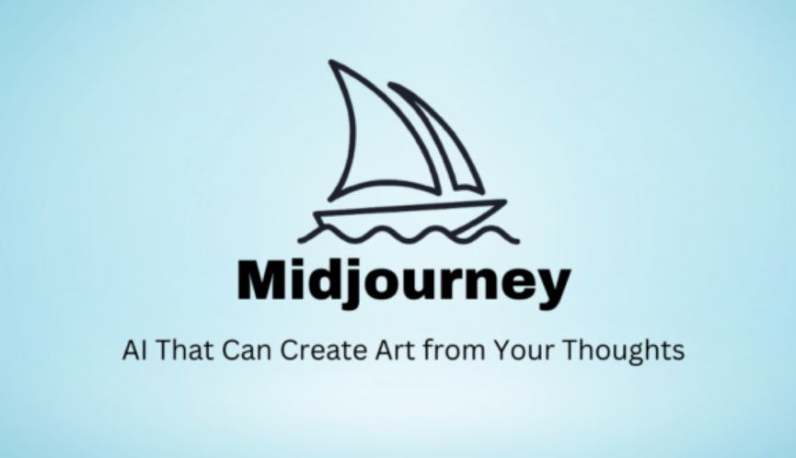
Midjourney AI
Midjourney is an example of generative AI that can convert natural language prompts into images.
Text-to-Image Conversion: Midjourney showcases generative AI's ability to transform text prompts into vivid images, blurring the line between language and visuals.
Underlying Technologies: Midjourney employs large language models to comprehend prompts, converting them into numerical vectors, which then guide the complex diffusion process.
Diffusion Models: Powered by transformer architecture, diffusion models progressively introduce randomness to images, refining the AI's ability to generate new content by learning to recreate original forms from distorted versions.

Slide 7
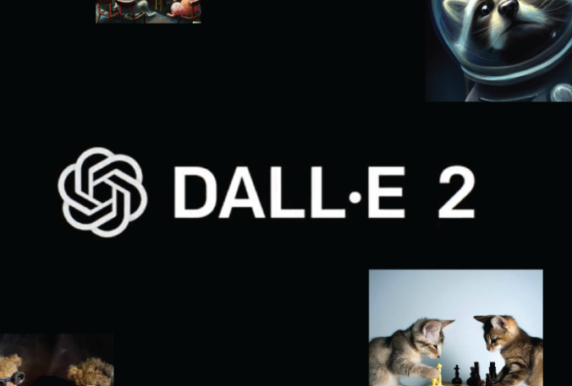
Dall.E 2
DALL·E is a state-of-the-art artificial intelligence program developed by OpenAI that creates images from textual descriptions.
Operational Stages: DALL·E 2's functioning involves three steps:
Text Encoding: A neural network processes prompts into text embeddings, resembling organized numerical representations.
Image Encoding: A separate model ('prior') maps text encodings to image encodings, enabling image generation.
Decoding: Using the generated image encodings, an image decoder produces visual content.

Slide 8
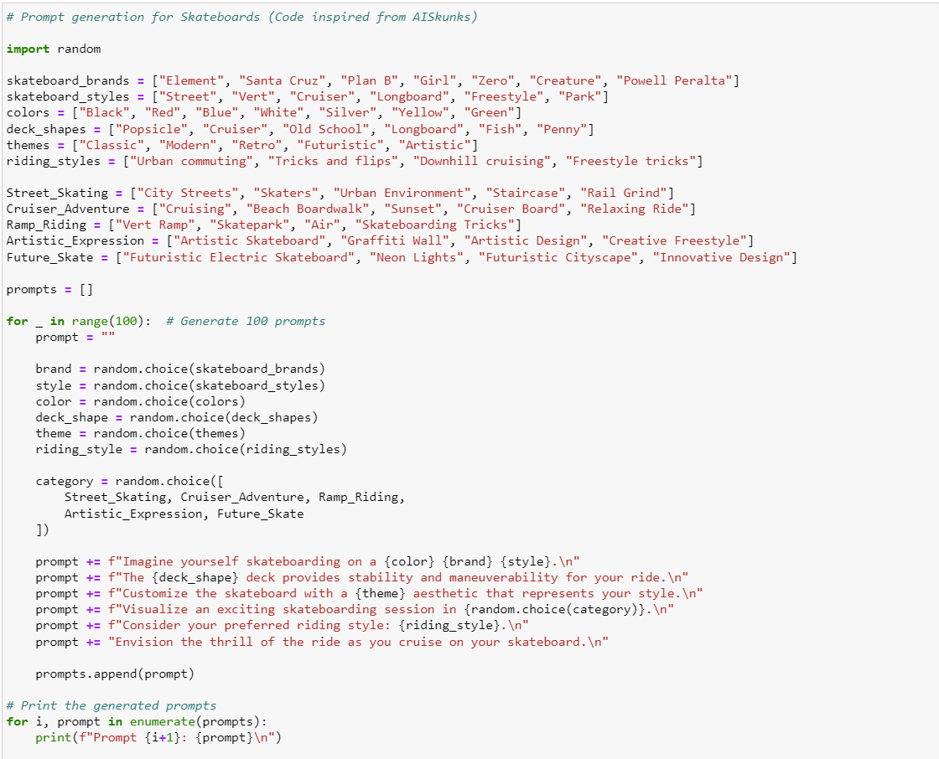
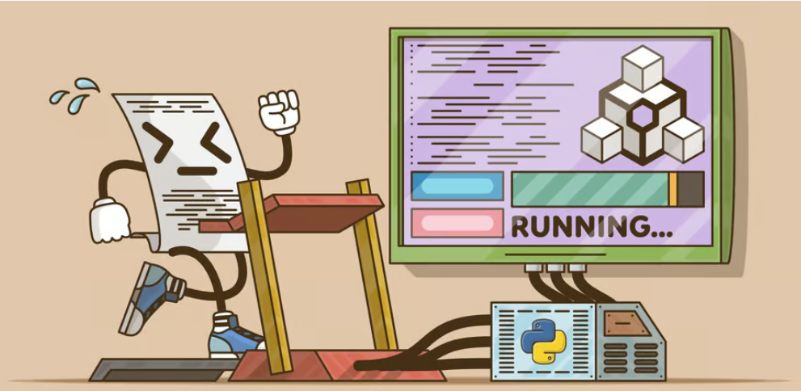
Generating creative prompts automatically

Slide 9
Superpowers of generative AI models
Image Synthesis: Generative AI models generate diverse images from text descriptions. Given phrases like "giraffe reading on a sunny day," it crafts detailed, unique images with intricate textures and contents.
Style Transfer: DALL·E 2 applies various styles to images, transforming photos into paintings, architecture into candy-like structures, and more. It can transfer a reference image's style to another, resulting in creative outputs.
Image Completion: DALL·E 2 fills missing parts of images based on context. For obscured objects, it intelligently completes the image, making it valuable for restoring damaged visuals and enhancing artistic compositions.

Slide 10

Use Generative AI models effectively
Clarity and Specificity: Clearly define the image you desire, specifying elements like style, subject, and colors for accurate results.
Simplicity in Language: Use simple language to avoid confusion and ensure precise interpretation by Generative models.
Contextual Insight: Provide context about image purpose, audience, and requirements for better alignment with your needs.
Utilize Examples: Share image examples you like, either through descriptions or links, to guide Midjourney/DALL·E-2's understanding.
Iterate and Refine: Experiment with variations of prompts, offer feedback, and make minor tweaks to enhance the generated images' quality and relevance.

Slide 11
Applications of generative AI models for image synthesis
Art and Design: Generative AI tools like Midjourney, Stable Diffusion, and DALL-E empower artists and designers to translate textual concepts into imaginative images, especially beneficial for digital artists and 3D modeling.
Advertising: Generative AI aids marketers in crafting captivating ads by generating images based on product or service descriptions, valuable for social media, online ads, and print materials.
Product Visualization: Midjourney facilitates rapid creation of product images, enabling efficient presentation of new offerings, advantageous for retail and e-commerce industries.
Movie and Video Game Concept Art: Generative AI generates concept art for movies and games, supporting visual exploration and aiding in speedy concept development.
Web Design: AI-generated images enhance web design by creating custom visuals that match design descriptions, valuable for personalized website graphics and backgrounds.
Innovation Ahead: These applications exemplify only a fraction of Generative AI's potential; its novelty leaves room for innovation across various domains in the future.

Slide 12

Thank you!

